Slide 1
SHIKSHA EKIKARAN
INTEGRATION OF SCHOOL, HIGHER AND TECHNICAL EDUCATION IN INDIA
WEEK - 3

Slide 2
Functional Requirements (updated)
The website is mainly made to show statistics about the education of different levels in a geographic location
It shows the students’ development area-wise/level-wise and what students are opting for in the next level
Constant updates to that governing bodies can add new policies or update them
Able to filter data to get better results, such as state and central, male and female, normal and handicapped, etc.,

Slide 3
PROCESS
The educational institutions register themselves on our website
After they register themselves, an admin will have to validate whether the registration is true or fake, done by checking their Institution’s government recognition number, and the history of the institution
Once the institution is verified, they get their special id, this would be different for each institution
They are expected to log in at the end of every quarter of an academic year and upload their data(mostly in the form of xlxs)
They upload their data as per the given template
Minor edits can be done on the website itself

Slide 4
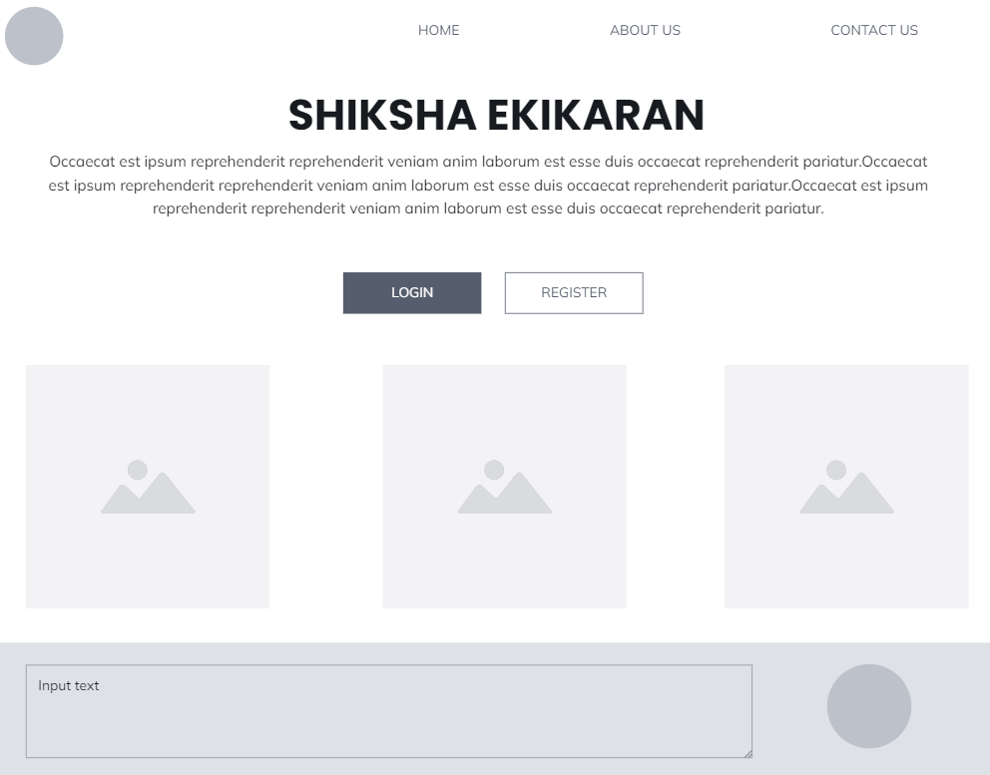

Slide 5
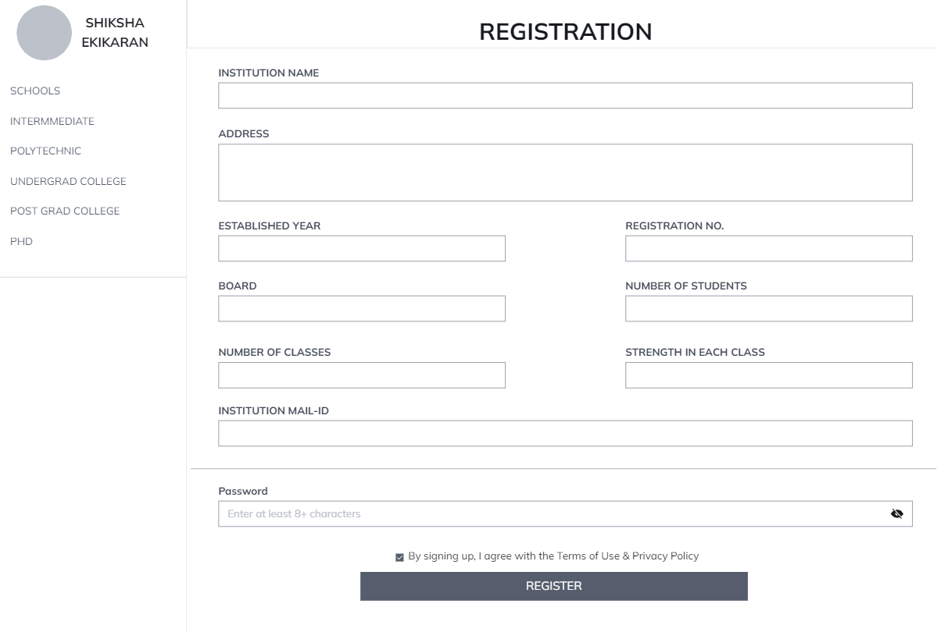

Slide 6
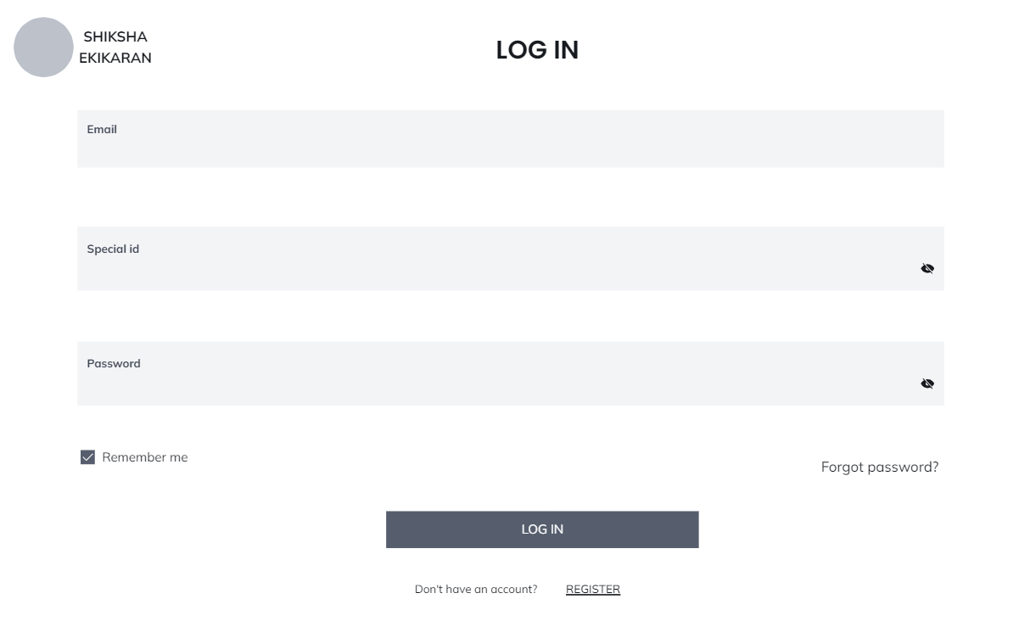

Slide 7
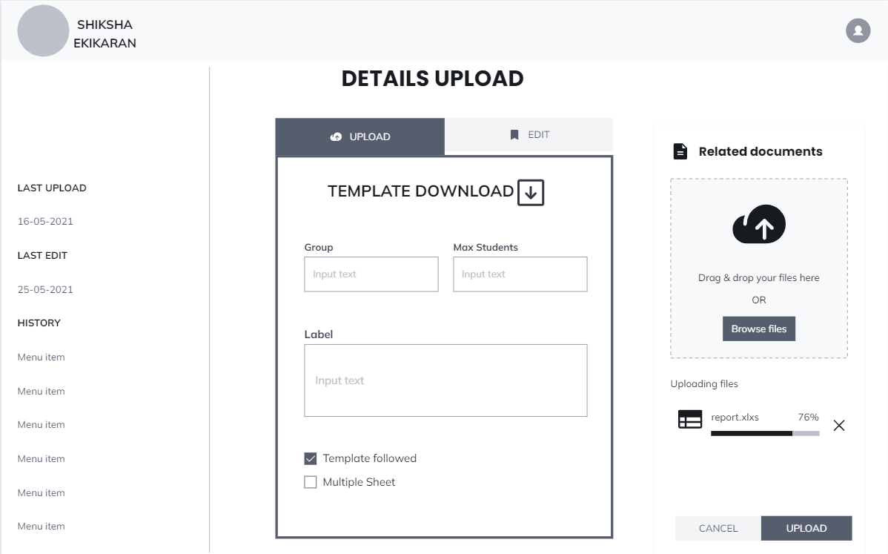

Slide 8
